Slide 1


Chunked, Compressed, & Cloud-native N-dimensional arrays
From Tensors to Clouds—Guide to Zarr-Python 3

Slide 2

Sanket Verma
https://sanketverma.com/
Community and OSS @ Zarr

Slide 3
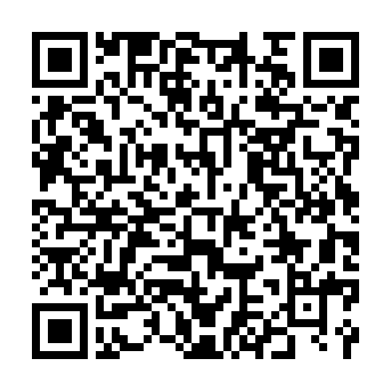
Slides
https://bit.ly/zp3_pycon_de

Slide 4

Slides & Notebook
https://bit.ly/zp3_more

Slide 5
What I’ll be talking about?
→ What is Zarr?
→ What’s new in the Zarr-Python 3?
→ Demo
→ How to get involved?

Slide 6
How Zarr works?

Slide 7
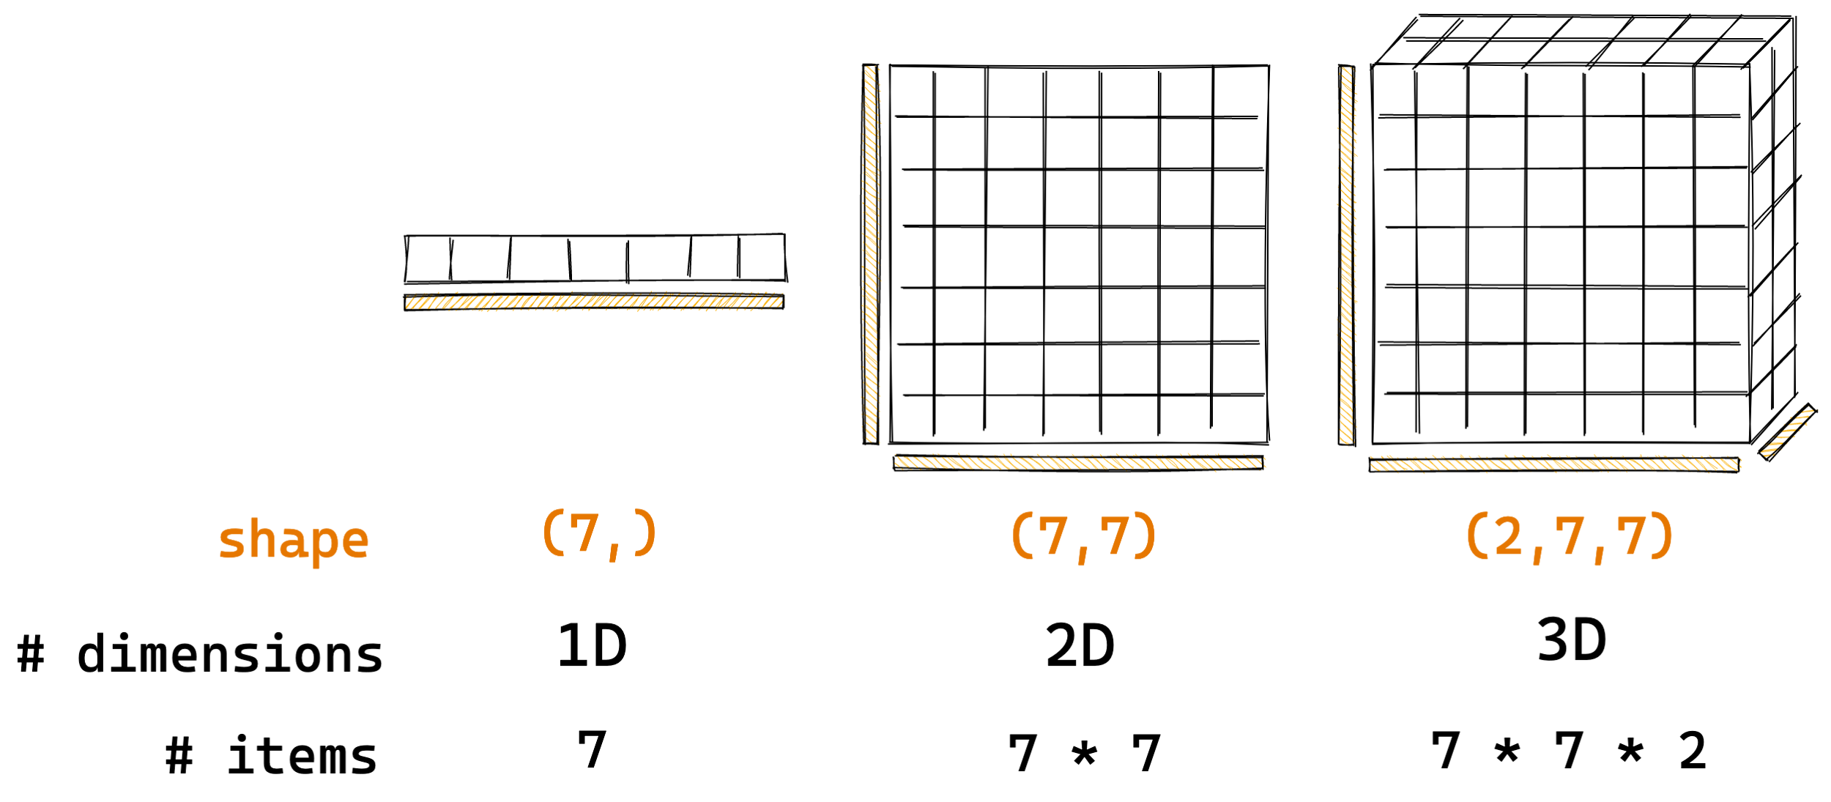
How Zarr works?
Arrays are container of items of the same data-type & size (in bits). The number of dimensions and items in container are described by the shape.
Credit: @trevmanz

Slide 8
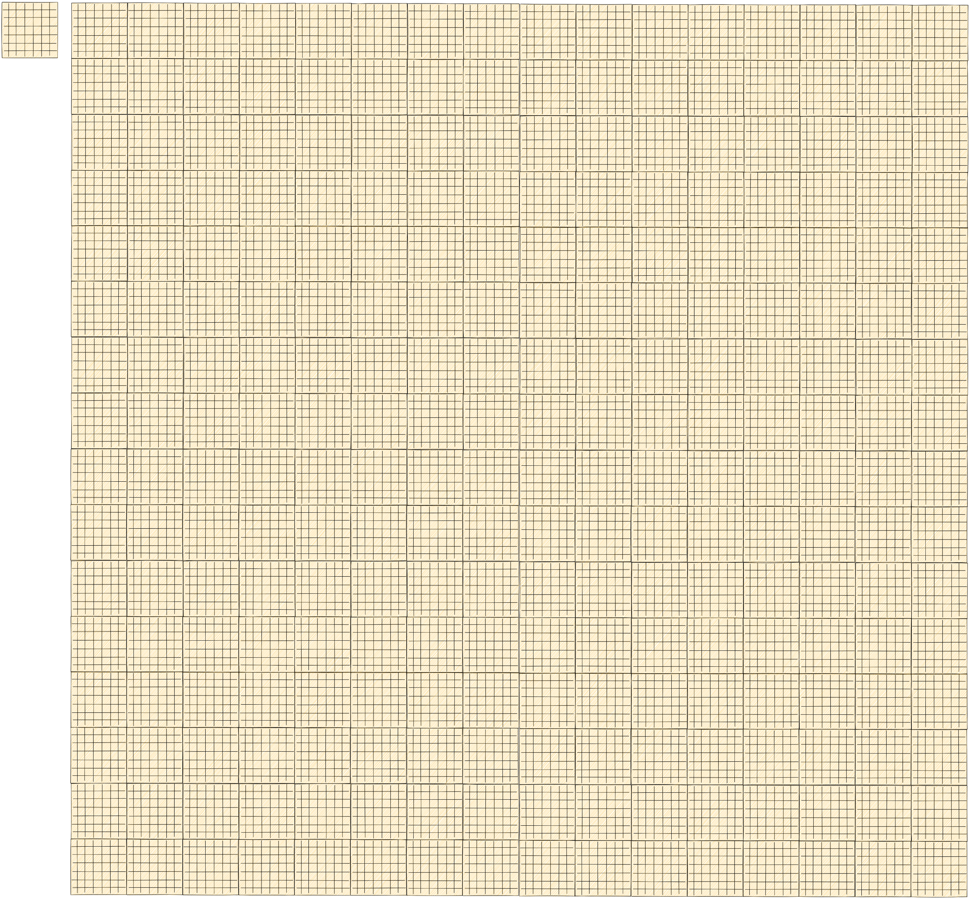
How Zarr works?
Credit: @trevmanz

Slide 9
How Zarr works?
What if the data is too big to fit in memory?
Credit: @trevmanz

Slide 10
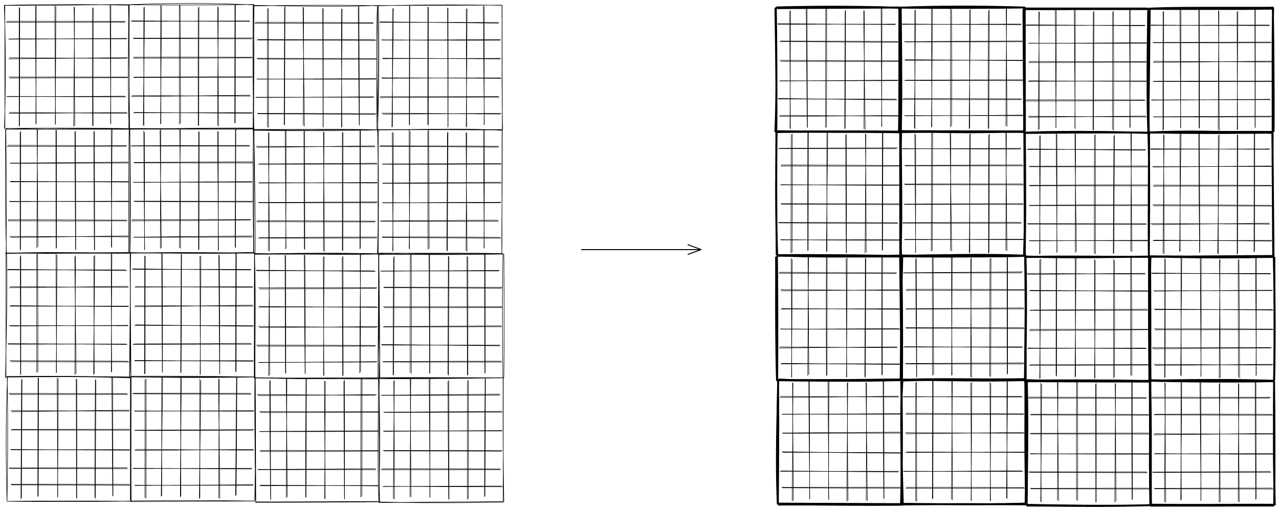
How Zarr works?
Divide array into chunks (Chunking)
Credit: @trevmanz

Slide 11
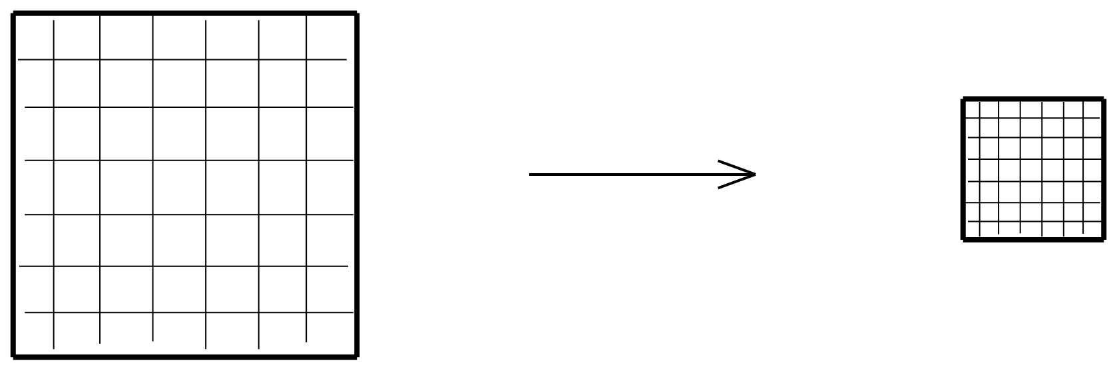
How Zarr works?
Compress each chunk
Credit: @trevmanz

Slide 12
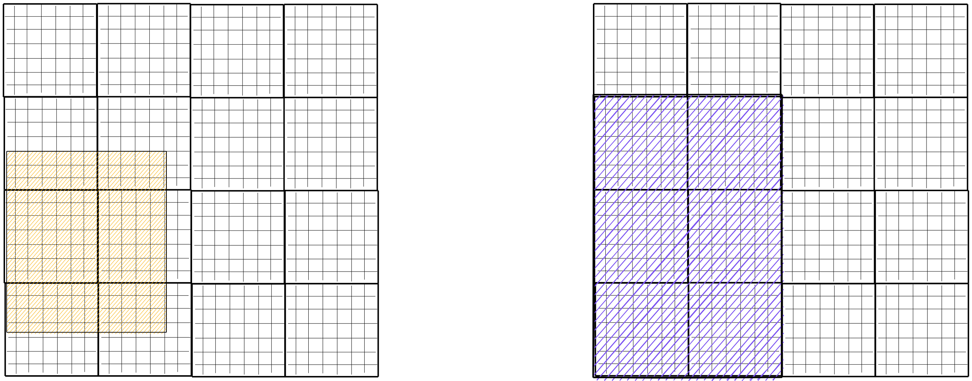
How Zarr works?
Retrieve chunks only when needed
Credit: @trevmanz

Slide 13
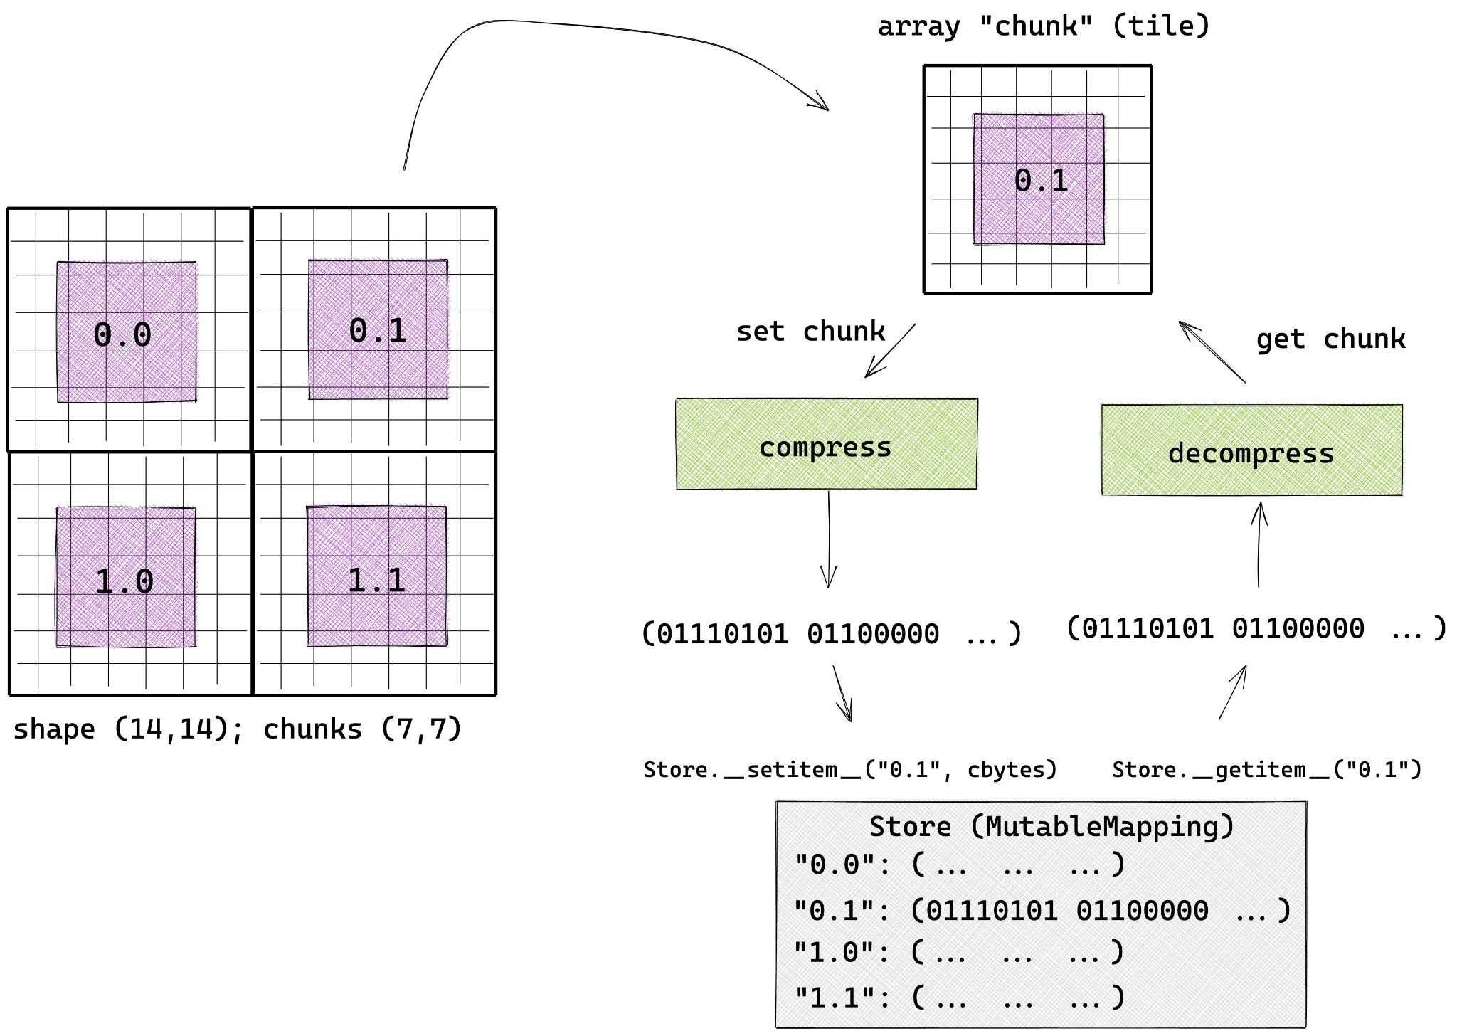
How Zarr works?
Credit: @trevmanz

Slide 14
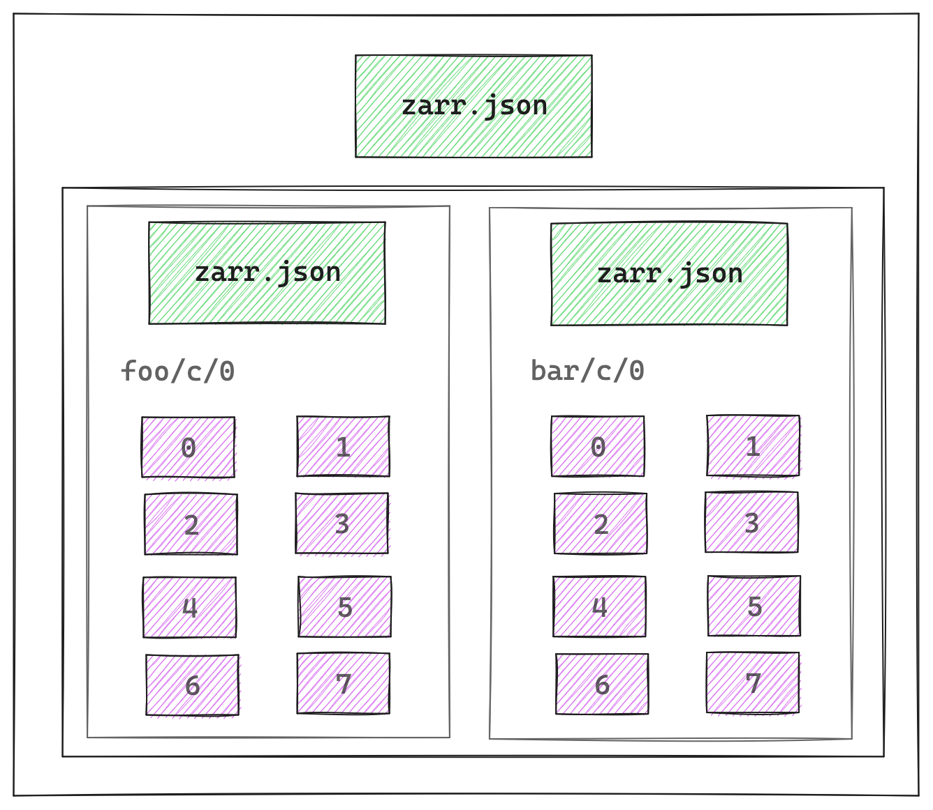
How Zarr works?
Multiple arrays can be organised in hierarchies of groups

Slide 15

Zarr Specification
V1 → V2 → V3
https://zarr-specs.readthedocs.io/

Slide 16
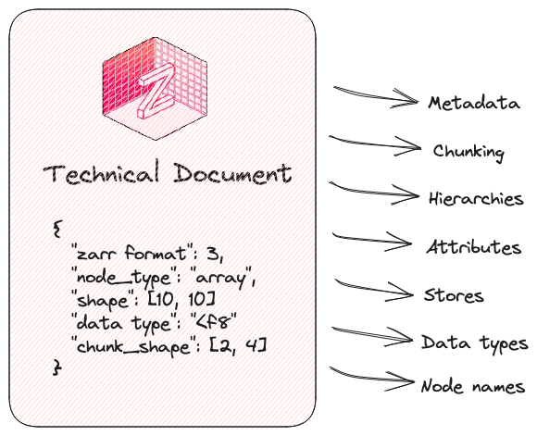
Zarr Specification

Slide 17







↔

Slide 18
What’s new in Zarr-Python 3?

Slide 19
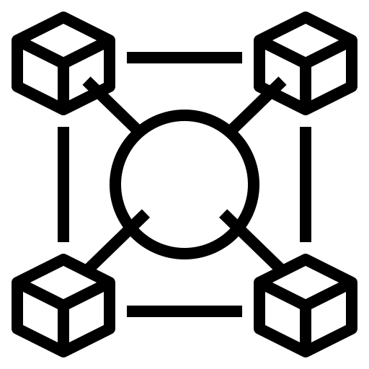


The Motivation
Interoperability High-latency storage
Extensibility
Notes:
Simple. → Spec.

Slide 20
Installation
$ pip install --upgrade zarr
or
$ conda install --channel conda-forge zarr

Slide 21
Installation
$ pip install “zarr[<extra>]”
where <extra> is:
gpu—support for GPUs
remote—reading/writing to remote data stores

Slide 22
Major design updates

Slide 23
New ABC Store
(Abstract Base Class)

Slide 24
ABC Store
→ Replaces MutableMapping base class
→ Allows extensibility to add new custom stores
→ Implements LocalStore, ZipStore and FSStore
→ Removed various exotic stores like SQLite, MongoDB, Redis, DBMS, LMDBS Stores

Slide 25
Custom Codecs via Entrypoint Mechanism

Slide 26
Custom Codecs
→ Enable flexible data compression and encoding strategies
→ Zarr includes Blosc, Zstandard and Gzip compressors only
→ Numcodecs has been adapted to use Zarr’s Codec entrypoint system

Slide 27
GPU support for Zarr arrays

Slide 28
Using GPUs with Zarr
→ zarr.config.enable_gpu() configures Zarr to use GPU memory
→ Zarr currently enable reading ndarray into GPU memory. Encoding and decoding still uses CPU memory

Slide 29
Changes and deprecations

Slide 30
Changes and deprecations
→ zarr.create_array() instead of zarr.array()
→ zarr.create_group() instead of zarr.group()
→ from zarr.storage import LocalStore instead of
from zarr import DirectoryStore

Slide 31
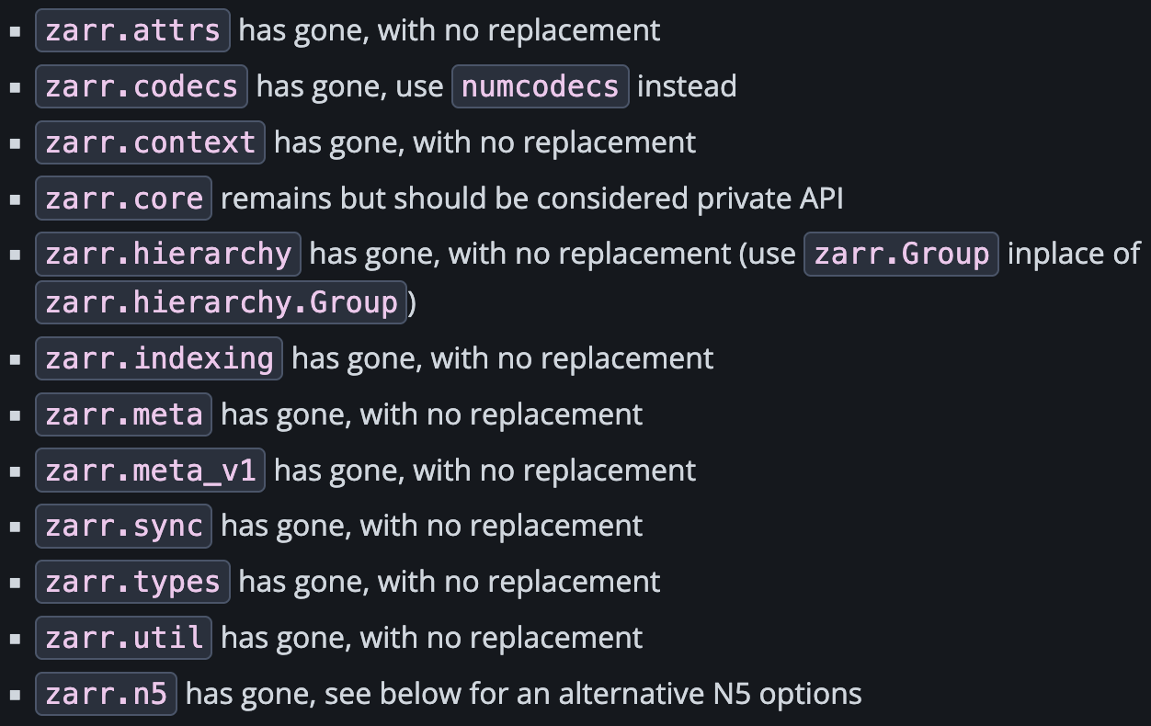
Changes and deprecations

Slide 32

Migration Guide
https://zarr.readthedocs.io/en/stable/user-guide/v3_migration.html

Slide 33
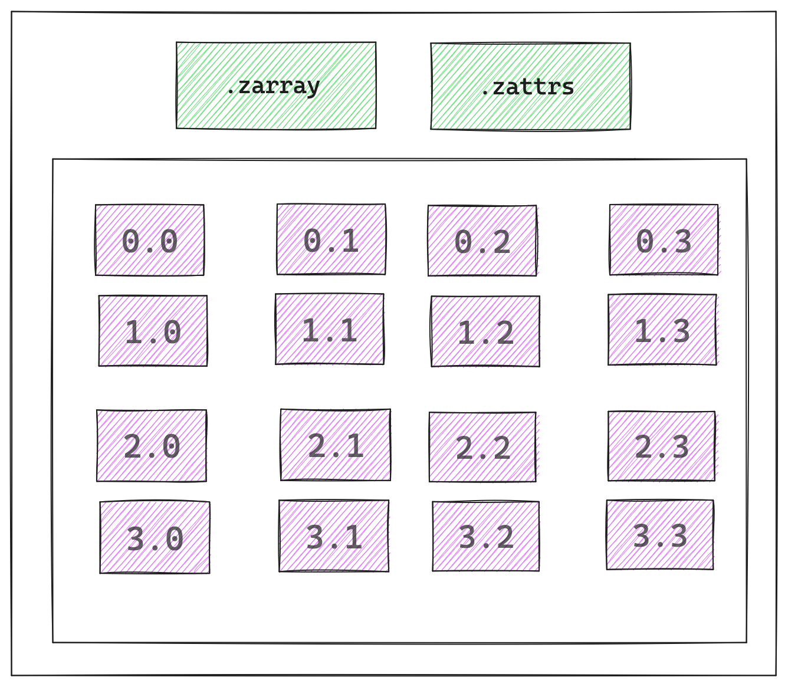
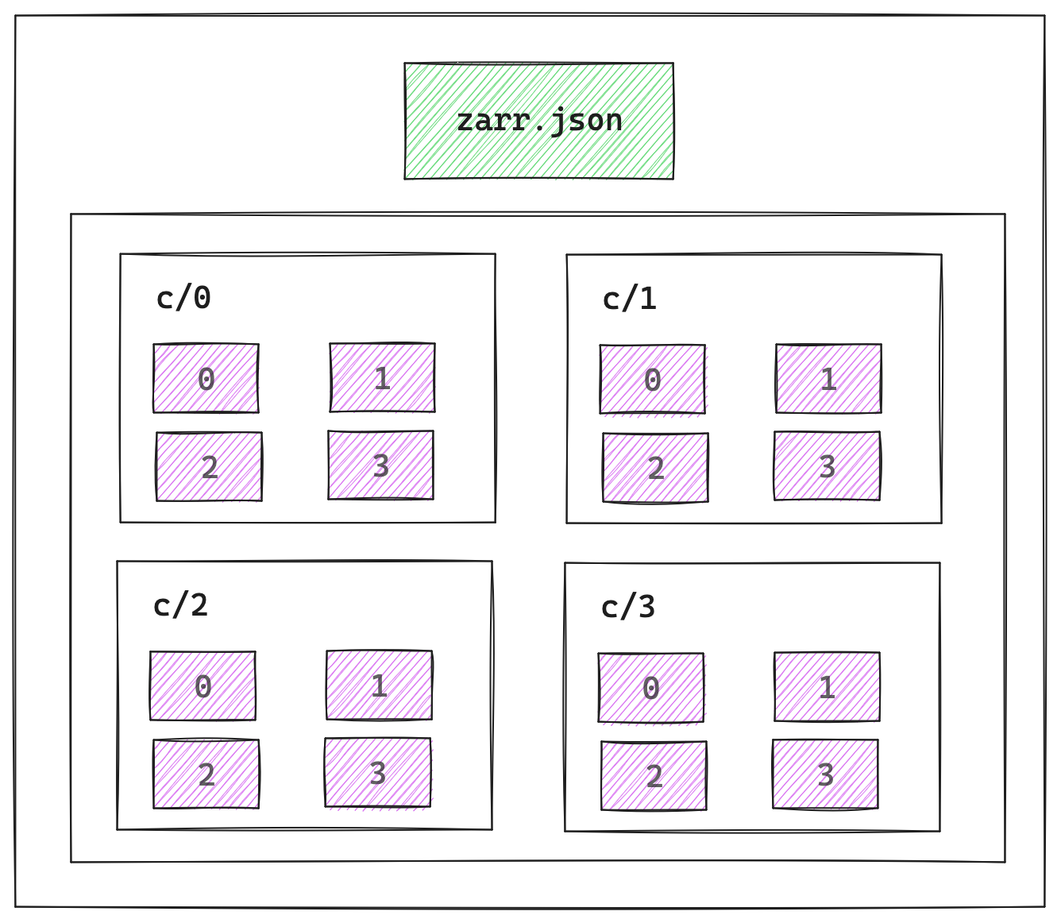
Zarr Arrays → V2 vs. V3
V2
V3

Slide 34
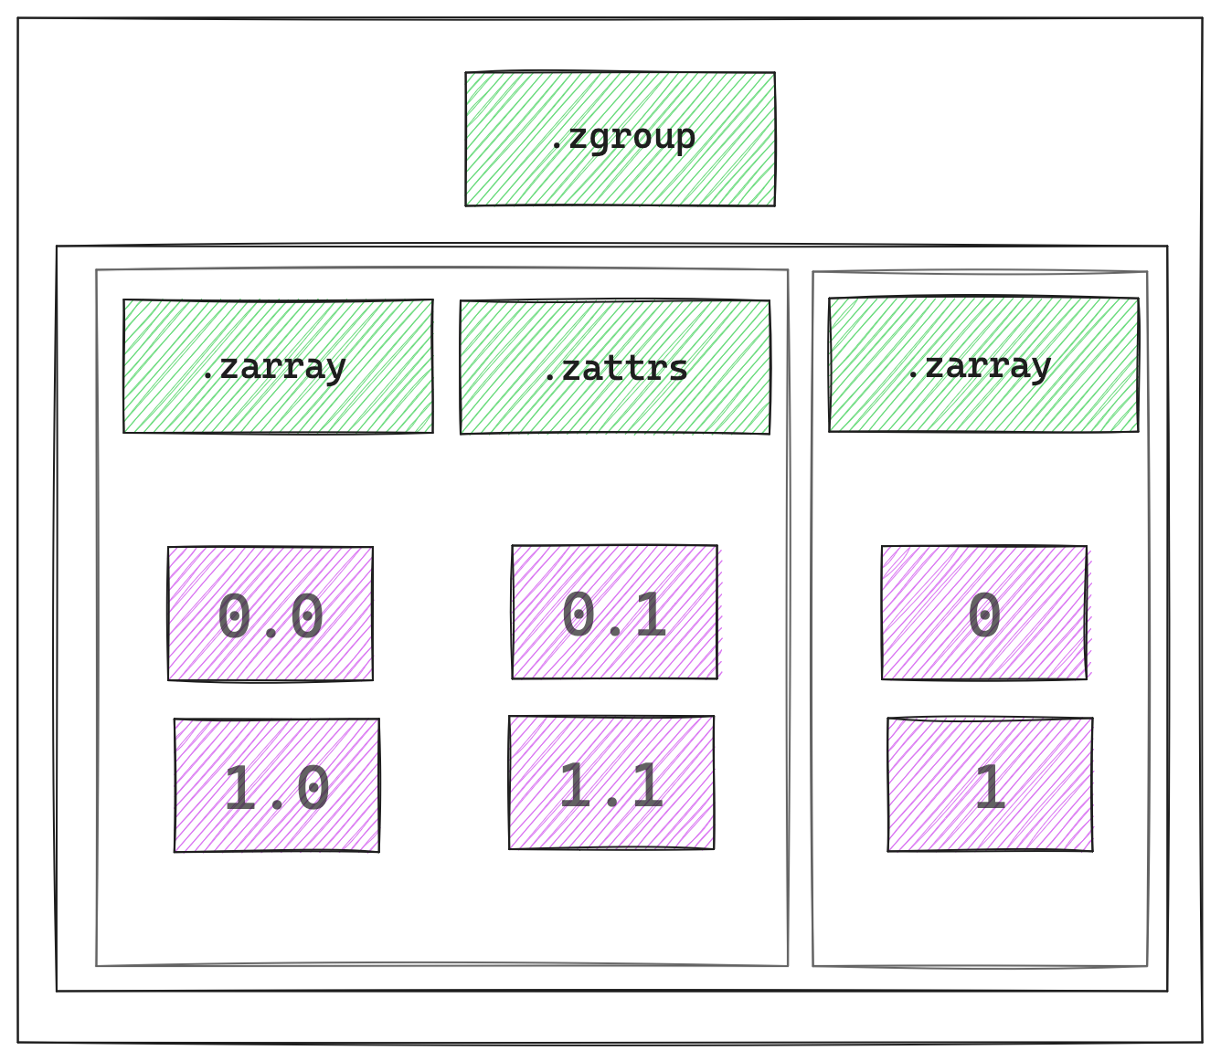
Zarr Groups → V2 vs. V3
V2
V3

Slide 35
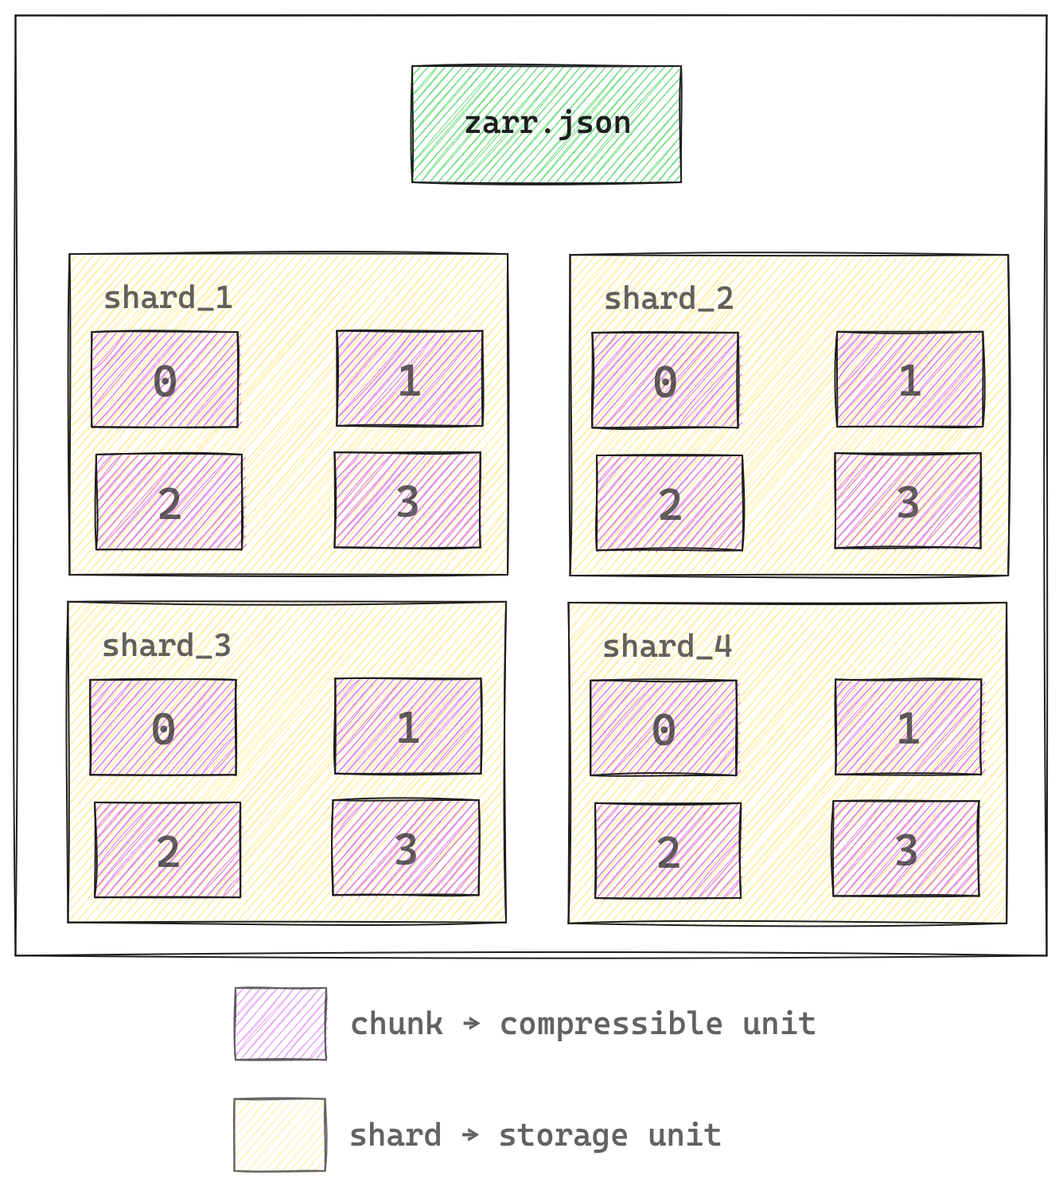

Sharding Codec
Via Extension Mechanism

Slide 36
Extensions

Slide 37
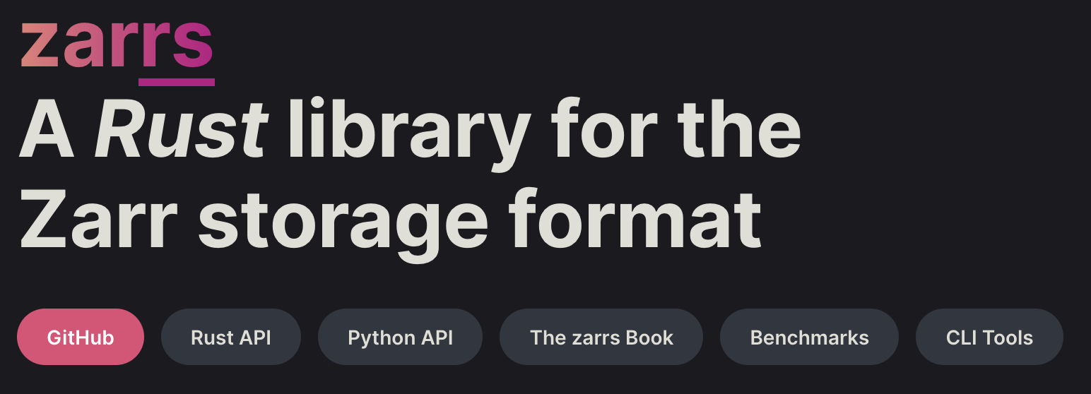

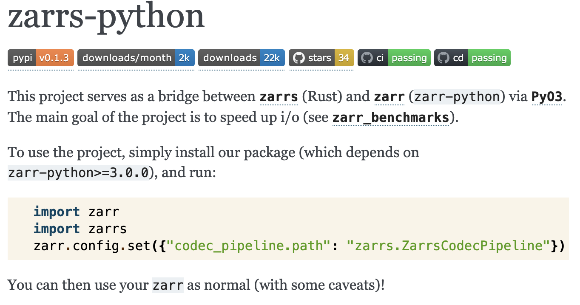
Credit: @joshmoore

Slide 38
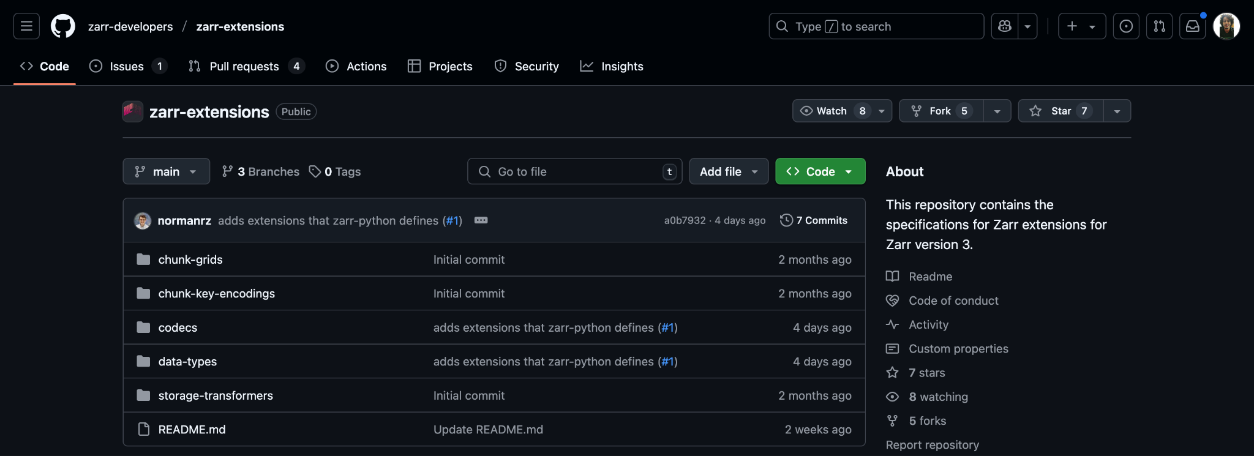
Register your extensions 👇🏻

Slide 39
Demo

Slide 40
How does V3 data looks like?

Slide 41



Citation:
Motta et al., Science 2019
Maintained by: /normanrz
(Norman Rzepka)
https://webknossos.org/links/NxMfC4B65CmTVGhr

Slide 42

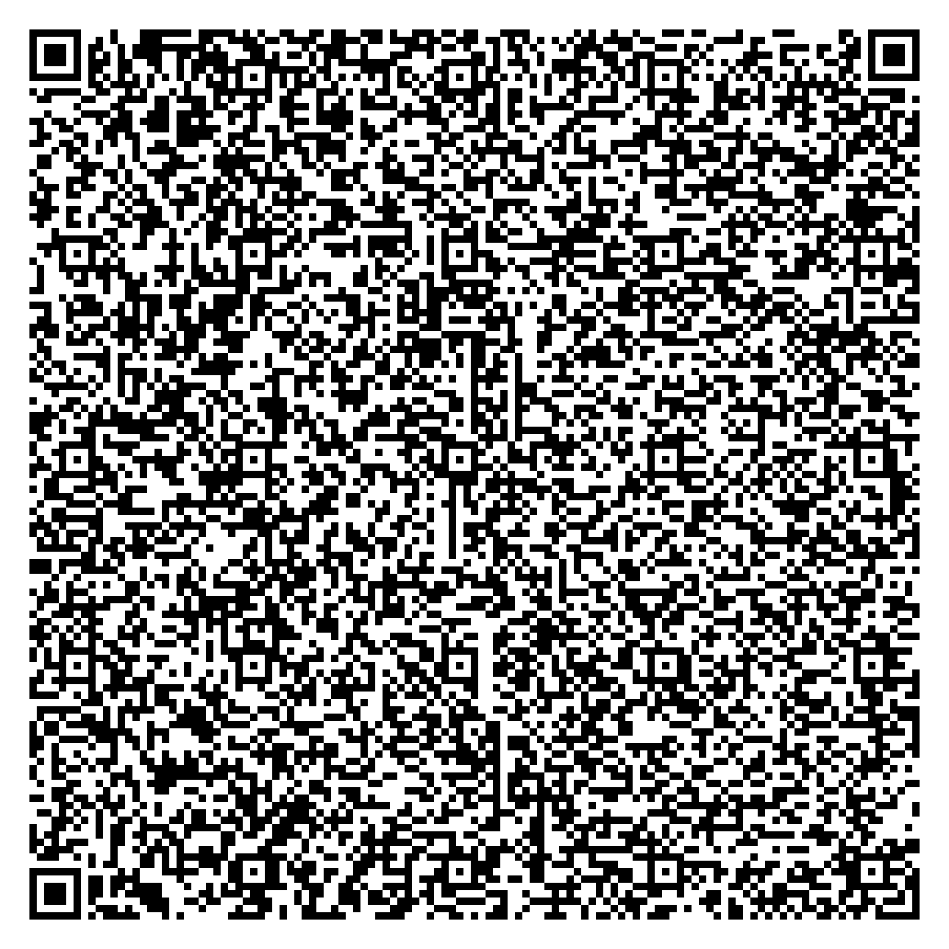
/neuroglancer
https://github.com/google/neuroglancer
Maintained by: /jbms
(Jeremy Maitin-Shephard)
Neuroglancer visualiser

Slide 43

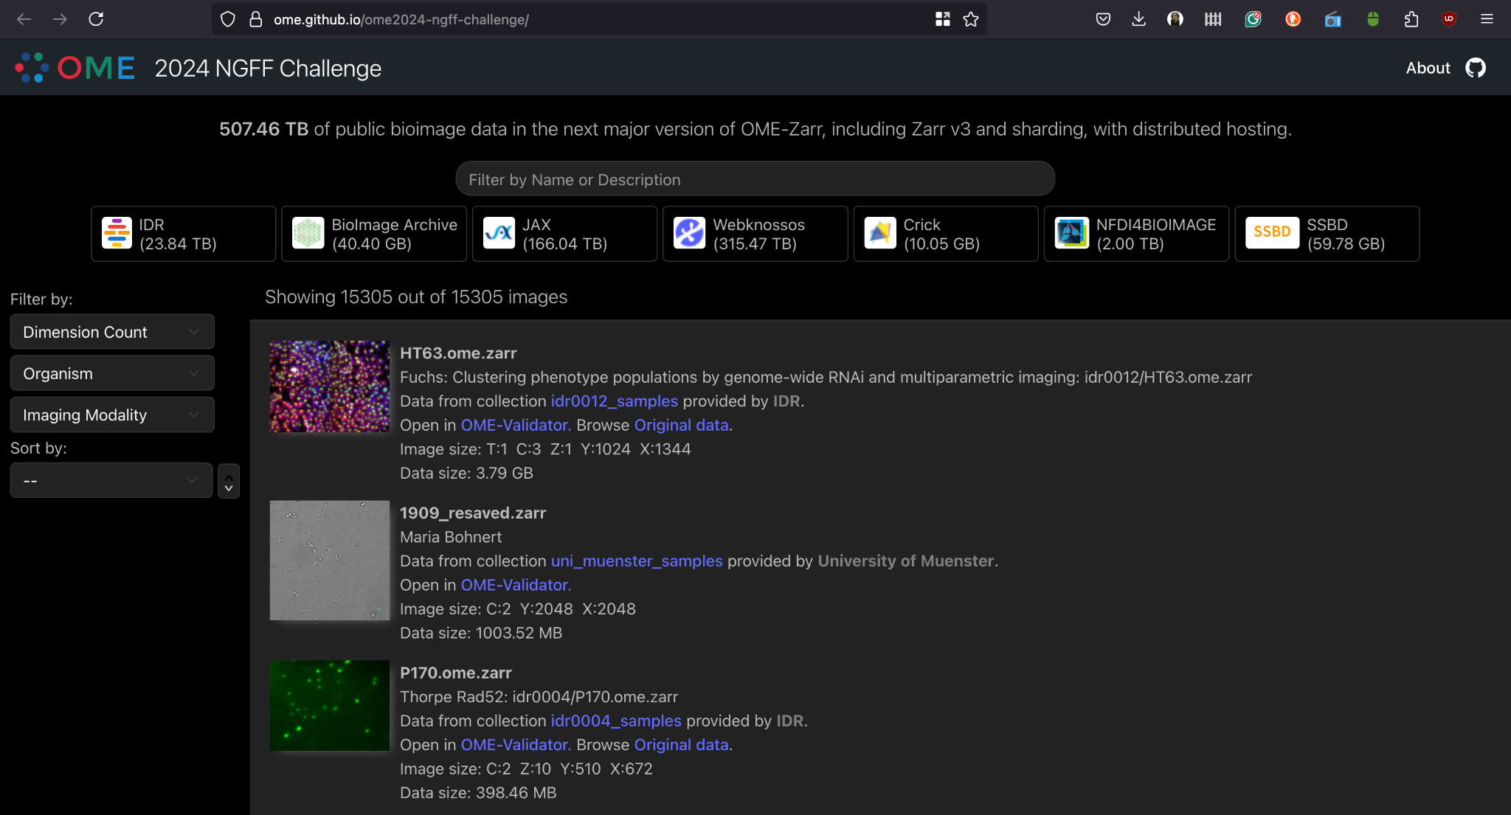
https://ome.github.io/ome2024-ngff-challenge/
Maintained by: /joshmoore
(Josh Moore)

Slide 44
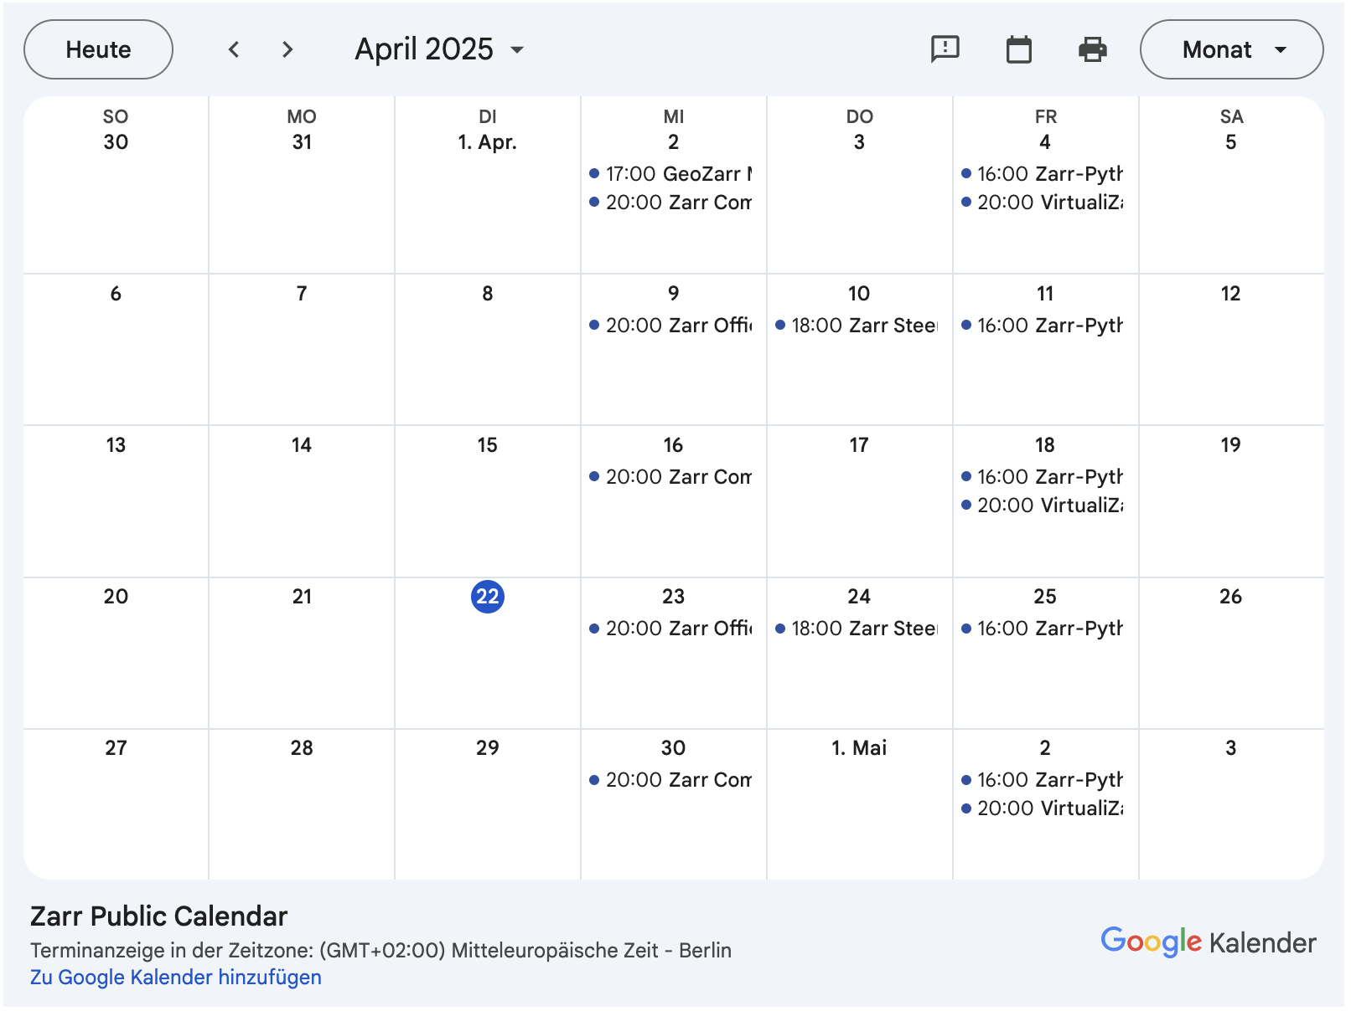
Join us at community, ZEP, core-dev meetings or office hours!
https://zarr.dev/community-calls/

Slide 45
Thank you! 🙏🏻
https://zarr.dev/

